Slide 1

Covid virus analysis

Slide 2
Introduction
The COVID-19 pandemic has had a profound impact on global health, economies, and societies around the world. Analyzing COVID-19 data plays a crucial role in understanding the spread of the virus, identifying trends, and informing public health interventions. In this analysis, we explore COVID-19 data using SQL to gain insights into key metrics such as confirmed cases, deaths, and recoveries. By querying and analyzing the dataset, we aim to uncover patterns, trends, and disparities in the spread and impact of the virus across different regions and time periods. This analysis will provide valuable insights that can inform decision-making, resource allocation, and policy development in response to the ongoing pandemic.

Slide 3
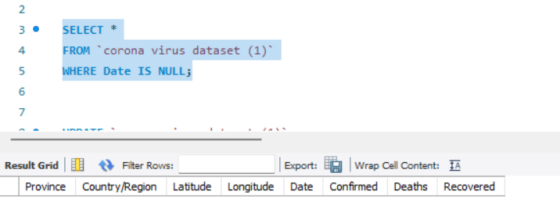
Second query
First query

Slide 4
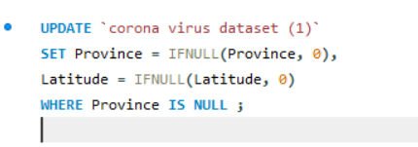
Second query

Slide 5
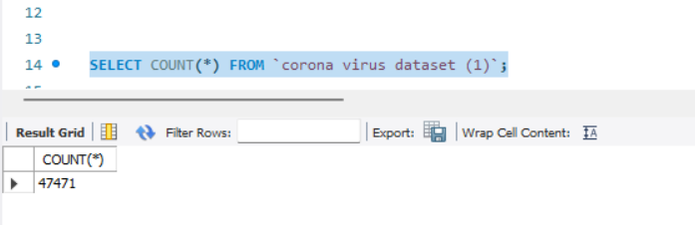
third query

Slide 6
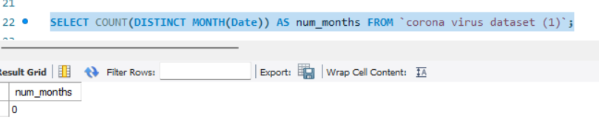
forth query

Slide 7
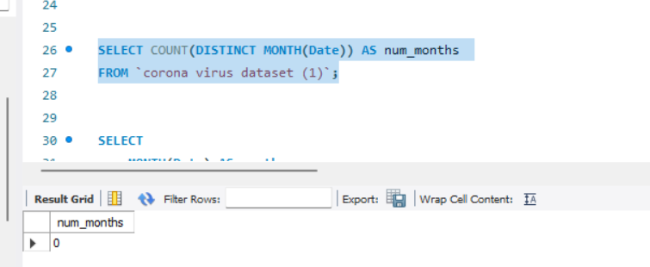
fifth query

Slide 8
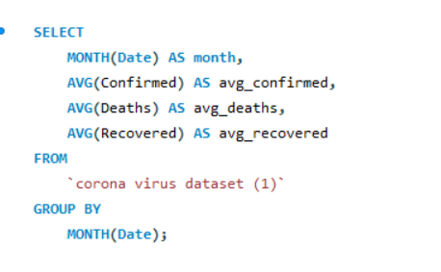
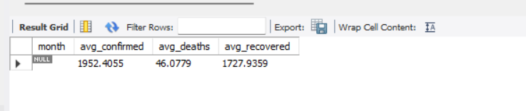
six query

Slide 9
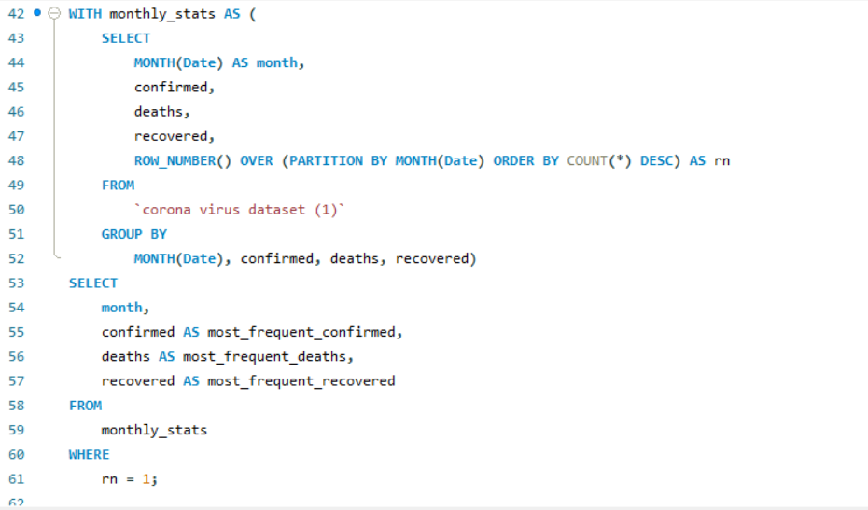
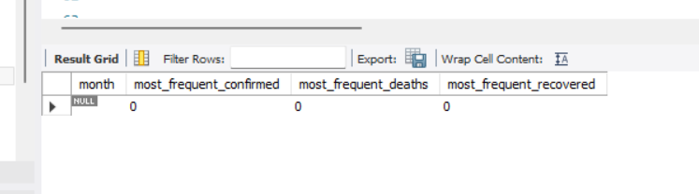
seven query

Slide 10
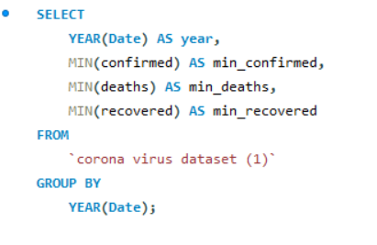
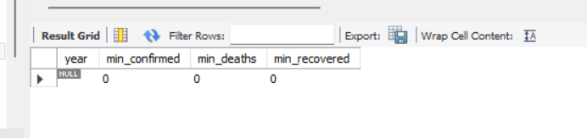
eight query

Slide 11
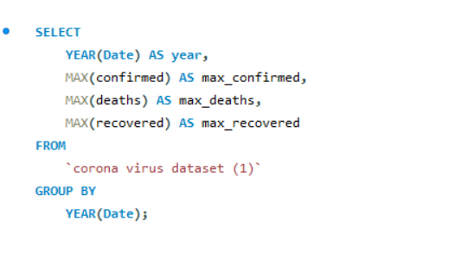
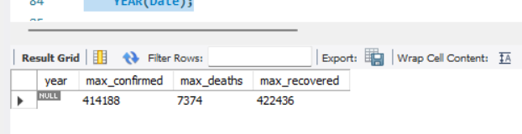
nine query

Slide 12
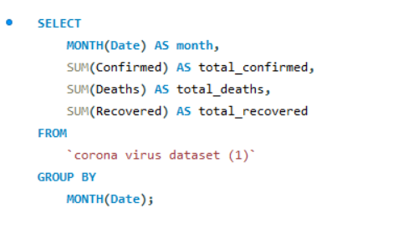
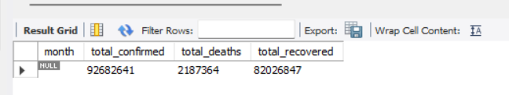
ten query

Slide 13
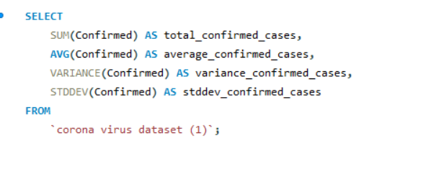
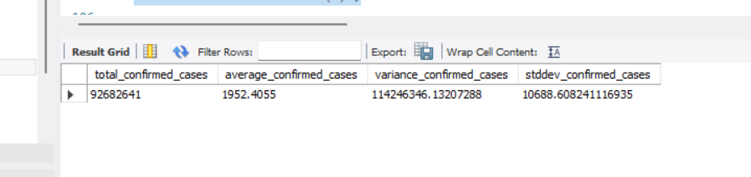
eleven query

Slide 14
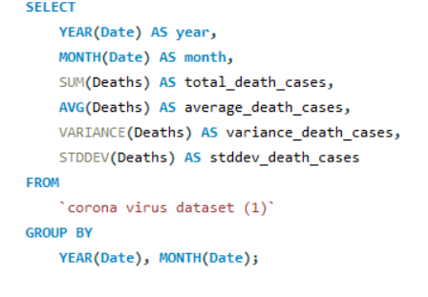
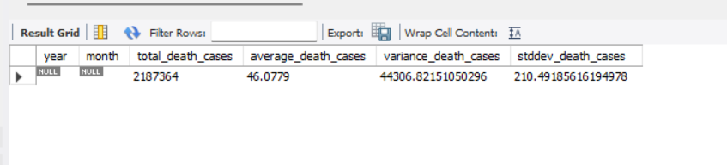
twelve query

Slide 15
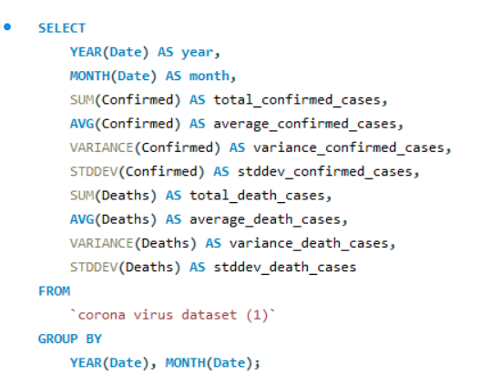
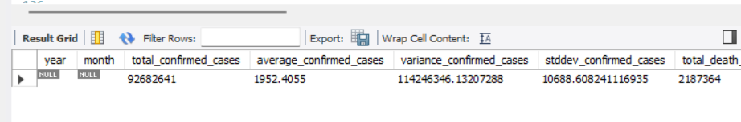
thirteen query

Slide 16
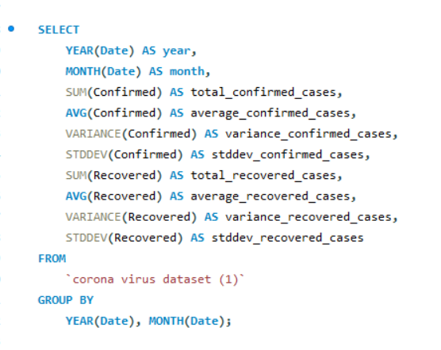
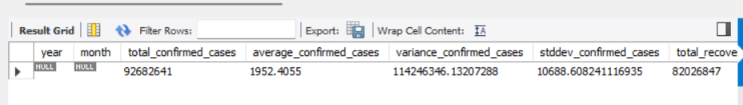
fourteen query

Slide 17
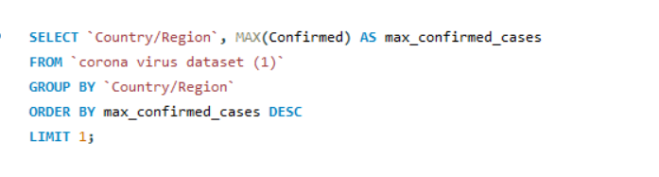
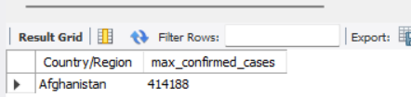
fiveteen query

Slide 18
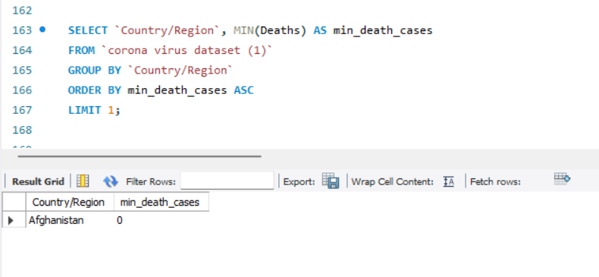
sixteen query

Slide 19
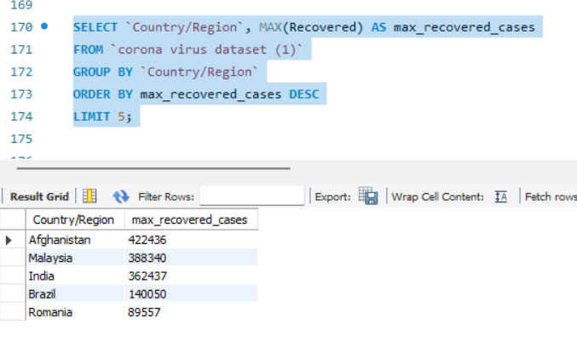
seventeen query

Slide 20
Thank you

